Slide 1
Sidesh Info Tech System (SITS)

Slide 2
Static Site Generator
A static site is a collection of pages contained in basic HTML files.
A static site generator (SSG) is a compromise between using a hand-coded static site and a full CMS.
You generate an HTML-onlywebsite using raw data (such as Markdown files) and templates.
The resulting build is transferred to your live server.

Slide 3
Static site
A static website is made of pre-built pages with content that doesn’t change between user visits.
A static site generator is an application that converts files (usually stored locally) into webpages.
The proposition of a static site is to shift the heavy load from the moment visitors
A static site is usually written in plain HTML .

Slide 4
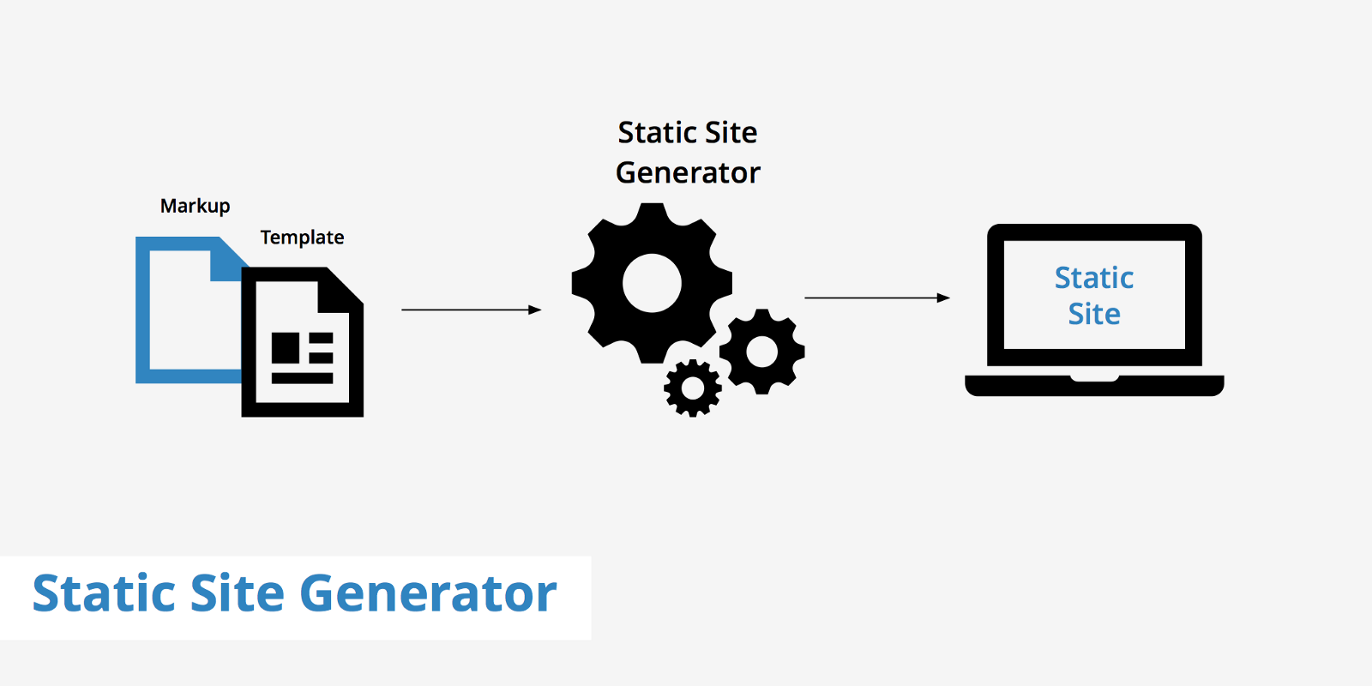

Slide 5
Benefit of Static Sites
Performance
There is no server side processing and no database to connect.
Hosting
Hosting requires no complicated setup or maintenance,making it cheap and easy.
Security
There are no server-side language issues to exploit and no database to hack;

Slide 6

Nuxt.js
Nuxt.js is not only a static site generator based on Vue.js. Infact it delivers multiple build options:-
Build server-side-rendered Vue.js SPAs (single-page-applications)
Generate static webpages from Vue.js code
Nuxt is a high level framework for developing universal JavaScript applications

Slide 7
Framework
The Nuxt.js framework bundels the following:-
Vue 2
Vue Router Vuex
Vue Server Renderer
vue-meta

Slide 8
PROs of Nuxt.js
Based on Vue.js
Easy to learn and to understand
Offers multiple build options
Comes with integrated state management (Vuex)

Slide 9
Cons of Nuxt
Not limited to generating static sites
Requires some basic understanding of Vue.js

Slide 10

Gatsby.js
It is created by Kyle Matthews.
Transform plain text into dynamic blogs and websites using the latest web technologies.
Gatsby is optimised for speed
Gatsby comes also with a plugin system which makes it easy to extend the static site generator .
Gatsby is based on React and GraphQL.

Slide 11
Features of Gatesby
Optimized for speed
Generates static PWA
A pre-configured Webpack-based build system

Slide 12
SPECS of Gatsby
language:-Javascript
Templates:-React

Slide 13
Why Gatsby
Gatsby has a rich plugin ecosystem.
Future proof Jamstack websites.
Everything is static.
Code splitting out of the box.
Speed.

Slide 14
PROs of Gatsby
Based on React
Data is pulled into Gatsby by using GraphQL
Very comprehensive plugin system available
Produces very fast static HTML pages with prefetching capabilities included
PWA-ready by default
Unit testing integration

Slide 15
CONs of Gatsby
You will need to have a solid grasp of JS, React, and GraphQL in order to get going with Gatsby.

Slide 16

It has been launched in 2013.
Jekyll is a a static site generator which is available since 2009
It is build based on top of Ruby.
GitHub Pages are public web pages for users, organizations, and repositories
Jekyll’s popularity is that it’s easy to use and requires just basic web development knowledge

Slide 17
Features of Jekyll
Most mature and popular
Supported by GitHub pages
A wide array of Plugins

Slide 18
SPECS of Jekyll
Language:Ruby
Template Engine:Liquid
License:MIT
Markup Languages:HTML, Markdown

Slide 19
PROs of Jekyll
Jekyll works very well with GitHub Pages which makes it extremly easy to get your Jekyll site hosted.
Jekyll is easy to learn and in general comes with a great simplicity in it’s core concepts.
Jekyll has a huge community, so it’s easy to find help to any topic related to Jekyll.
If you want to extend the standard functionality of Jekyll you can make use of a long list of available plugins.

Slide 20
CONs of Jekyll
Jekyll is based on Ruby. That means that you have to set up your Ruby development environment to make use of Jekyll first.
As Ruby is not included in the top trending programming languages for web development in 2019 you might find Jekyll a little bit outdated.
It's slow for sites with a lot of posts
Little Windows support

Slide 21
NEXT.JS
Next.js is a very popular static site generator based on React and JavaScript and provided by ZEIT, a company which is focusing on making cloud computing as easy as possible.
Next.js is much simpler and effective than its alternatives.
Next.js is a very modern platform and providers features like:
Server-rendered by default
Automatic code splitting for faster page loads
Simple client-side routing (page based)
Able to implement with Express or any other Node.js HTTP server
Customizable with your own Babel and Webpack configurations

Slide 22
features of Next.js
Server-rendered by default (Yay!)
Automatic code splitting for faster page loads
Simple client-side routing (page based)
Webpack-based dev environmet which supports Hot Module Replacement(HMR)
Able to implement with Express or any other Node.js HTTP server
Customizable with your own Babel and Webpack configurations

Slide 23
PROs of Next.js
Based on React and JavaScript
Easy to get started with, high learning curve (and even higher if you have already a basic understanding of React)
Seamlessly integrates with ZEIT now hosting service
Next.js is backed by an organisation and also has a strong support in the open-source world
Start with zero configuration
Code splitting out of the box

Slide 24
CONs of Next.js
Requires some basic understanding of React
No integrated plugin system available

Slide 25
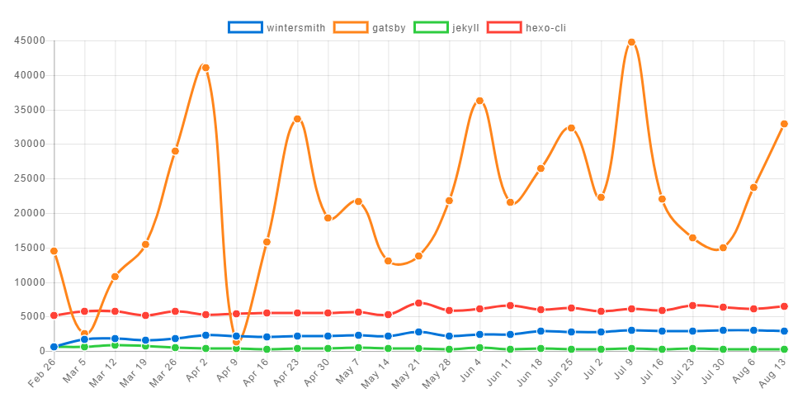
Community view

Slide 26
My Opinion
My opinion is that gatesby is good for developing any website because gatesby is popular in the present time.
It is also easy as compare to the other framework.

Slide 27
Reference:-
https://www.slant.co/topics/330/~best-static-site-generators
https://hub.packtpub.com/top-5-open-source-static-site-generators/
https://medium.freecodecamp.org/use-react-with-next-js-framework-and-how-it-made-my-life-easier-4280b643451

Slide 28
Thank You

